Slide 1



Team no - 4
UDYOG SAARTHI APP
JOB OPPORTUNITIES UNDER 4% PWD RESERVATION
Presented By Team no - 4

Slide 2


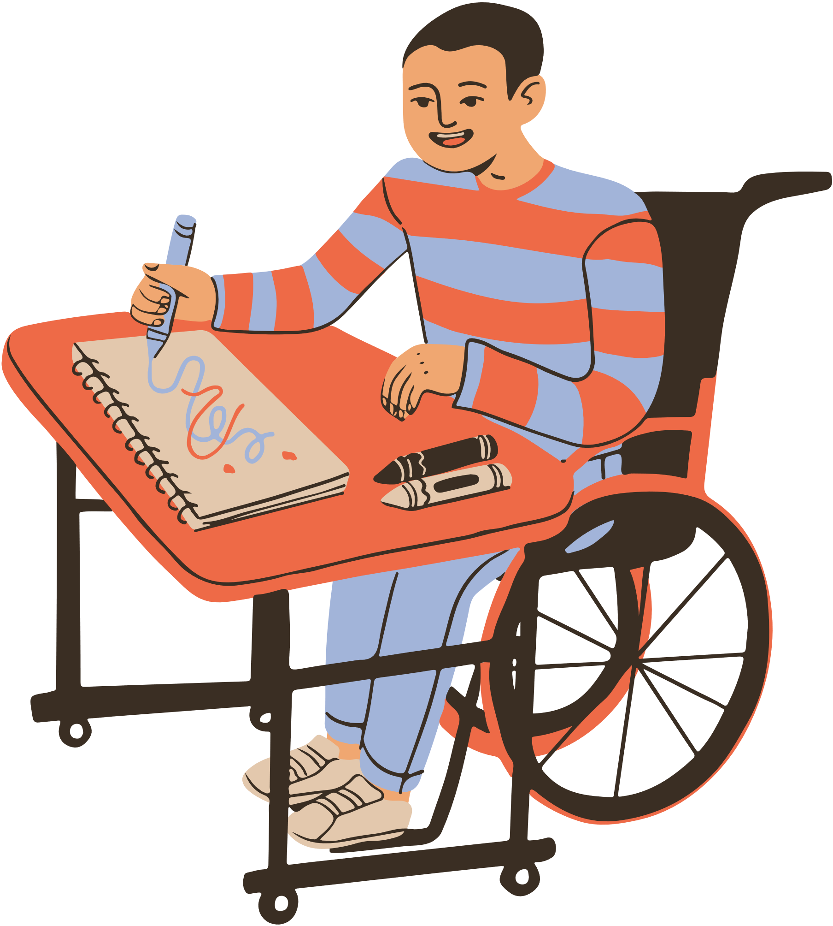
Problem Statement
The Udyog Saarthi App addresses a critical challenge faced by adults undergoing job coaching, specifically those seeking employment opportunities under the 4% reservation in institutions like the National Institute for the Empowerment of Persons with Multiple Disabilities (NIEPMD) and similar organizations. Individuals with disabilities often encounter barriers in accessing job coaching resources tailored to their unique needs
Back to Agenda

Slide 3

Objectives
Inclusive Skill Development: Enable inclusive and accessible skill development modules tailored to the diverse needs of individuals with disabilities undergoing job coaching
User-Friendly Interface:
Design a user-friendly interface for easy navigation, ensuring accessibility for individuals with varying levels of technical proficiency
Progress Tracking and Adaptability:
Implement robust analytics for progress tracking and reporting, while ensuring the app remains adaptable to changes in the job market through regular updates.

Slide 4





AGENDA
Job Platform for Pwd candidates: specialized job platform designed specifically for candidates with disabilities. Our platform aims to connect talented individuals with companies that value diversity and inclusion
Customized job notifications : By setting up customized job notifications, you can receive alerts tailored specifically to your preferences, making your job search more efficient and effective
Courses for preparation: or exams, job interviews, or other important events can be incredibly helpful in boosting your confidence and knowledge. By enrolling in preparation courses, you can gain valuable insights, tips, and techniques that can significantly improve your performance.

Slide 5







METHODOLOGY
NIEPMD
Data Filtering
Source
Notification Generated
User Profile
Dashboard
Preparation for Exam

Slide 6
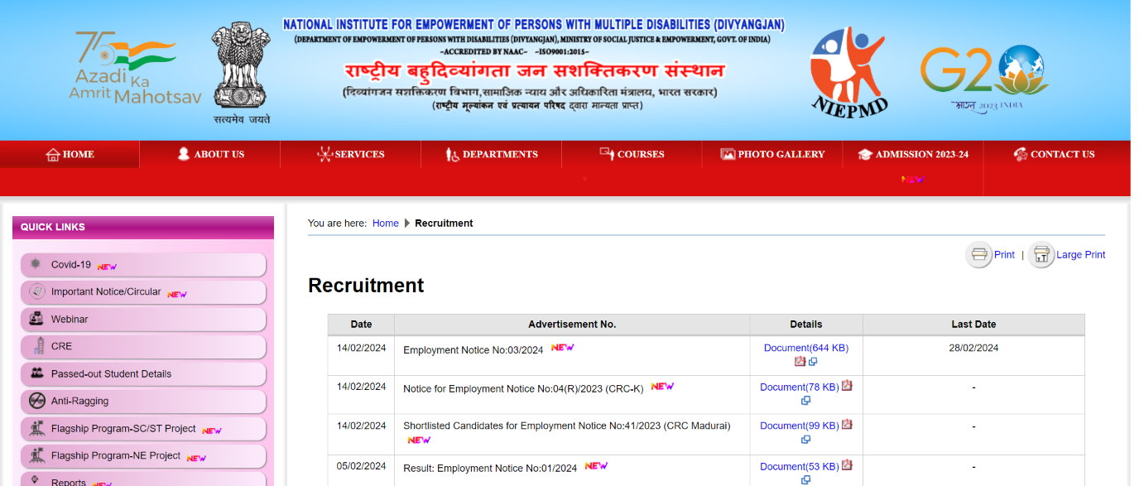
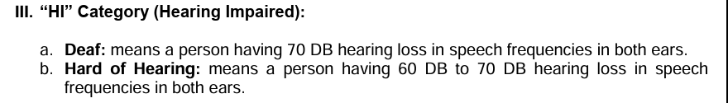
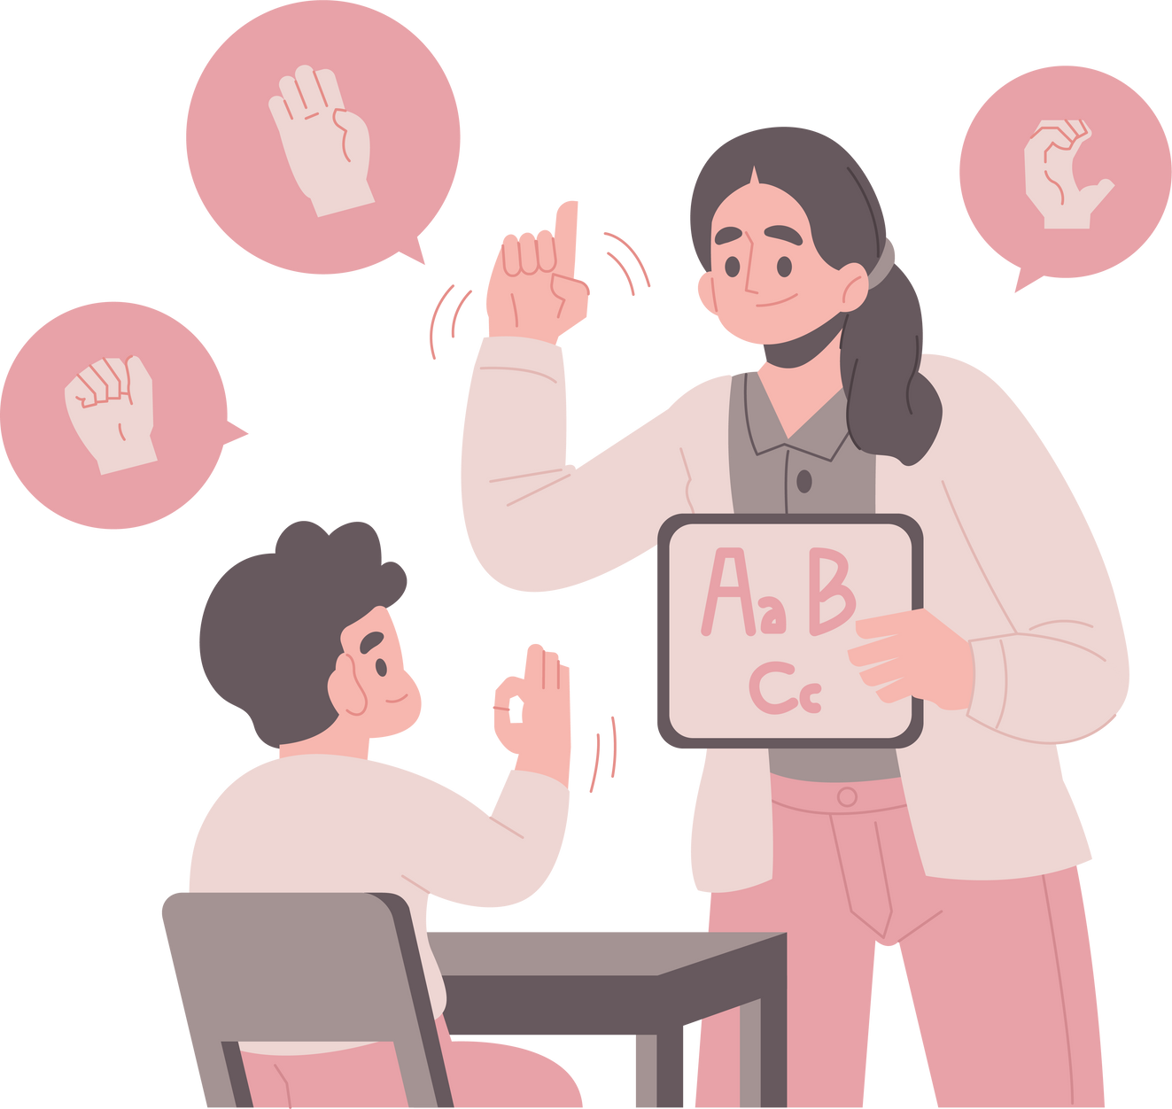
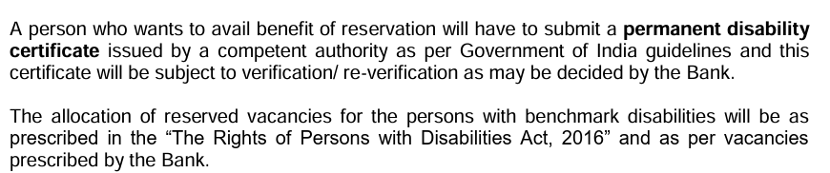

Slide 7
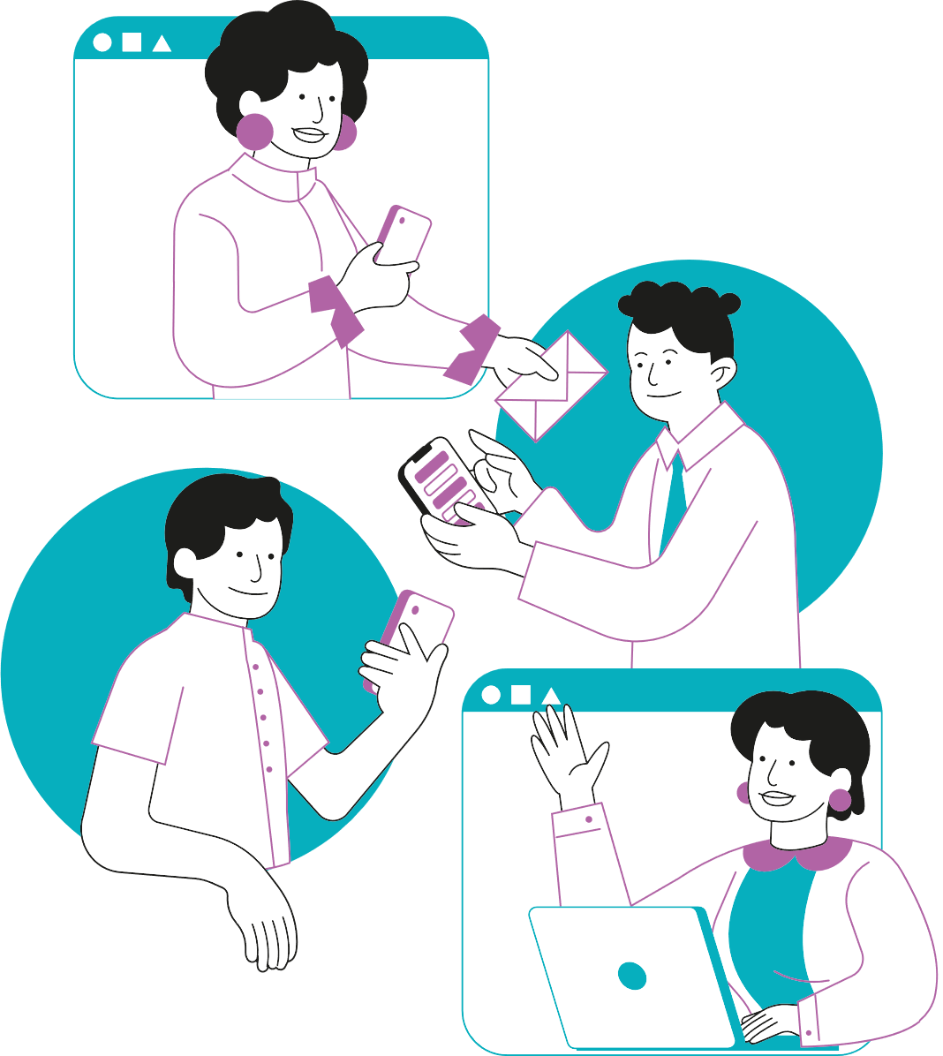




Government collaboration
Communication
Data collection & Processing
Challenges
Technical Notification
Diverse Learning

Slide 8

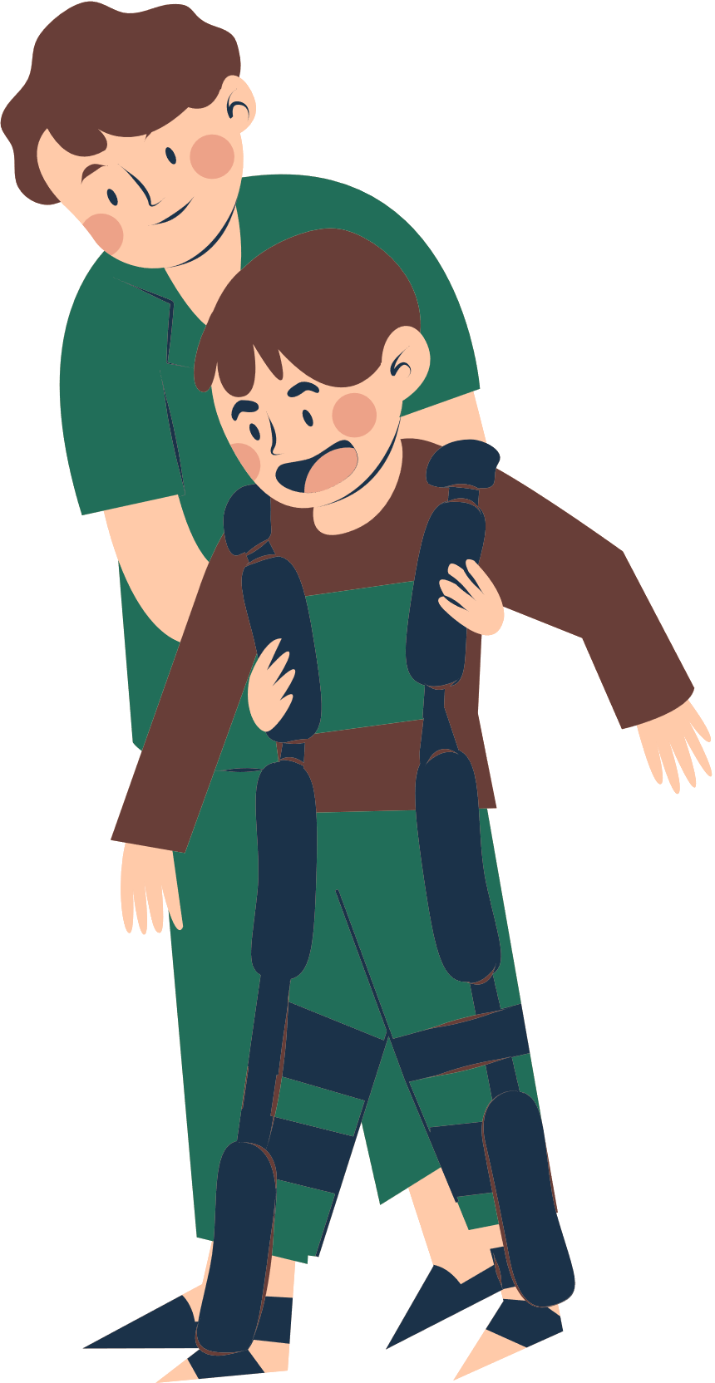
Outcome
Improved Skill Proficiency
Enhanced Employability
personalized learning paths
Career Advancement Opportunities:
increased confidence to enter the workforce under the 4% reservation quota.

Slide 9

Research Paper
Towards a disability inclusive education -Nidhi Singal
January 2015
Education of children with disabilities in India and Pakistan: Critical analysis of developments in the last 15 years - August 2016
Factors associated with persons with disability employment in India:
Persons with Disabilities Facing the Mirage of the Right to Education:

Slide 10



